Slide 1
Data Structures ICT-1211 Information and Communication Technology
Lecture-31
Date: //

Slide 2
Sorting and Searching

Slide 3
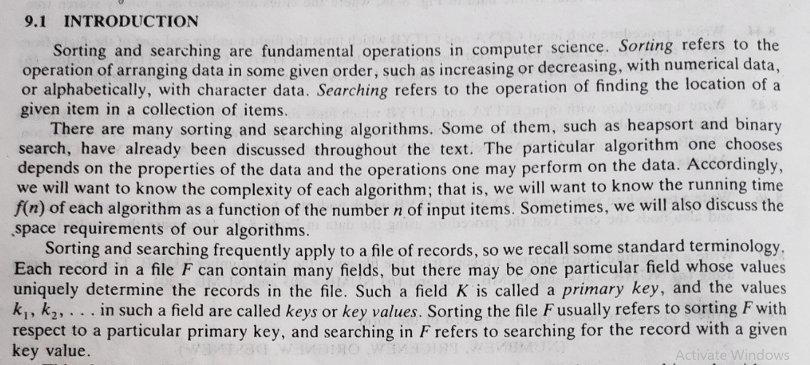
Sorting and Searching

Slide 4
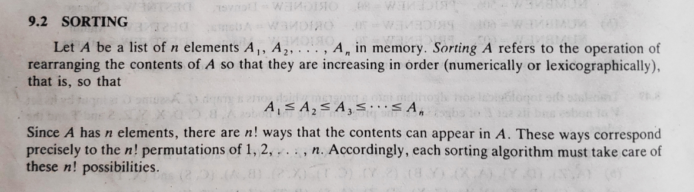
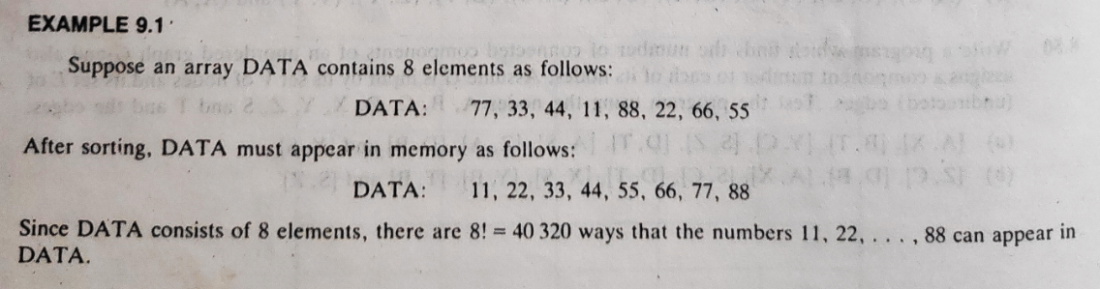
Sorting and Searching

Slide 5
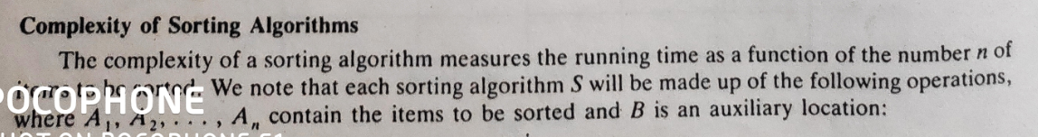
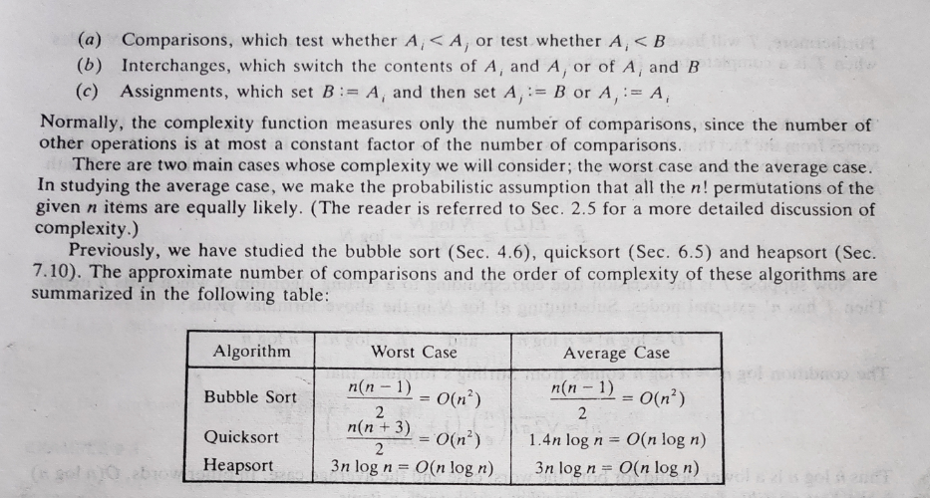
Sorting and Searching

Slide 6
Insertion sort

Slide 7
Insertion sort
Insertion sort is a simple and eﬃcient sorting algorithm useful for small lists and mostly sorted list. It works by inserting each element into its appropriate position in the ﬁnal sorted list. For each insertion it takes one element and ﬁnds the appropriate position in the sorted list by comparing with neighboring elements and inserts it in that position.

Slide 8
Insertion sort
This operation is repeated until the list becomes sorted in the desired order. It becomes more ineﬃcient for the greater size of input data when compared to other algorithms. The algorithm that explains insertion sort is as follows.

Slide 9
Insertion sort
Suppose an array A with n elements A[1], A[2], …, A[N] is in memory. The insertion sort algorithm scans A from A[1] to A[N], inserting each element A[K] into its proper position in the previously sorted subarray A[1], A[2], …., A[K – 1]. That is:

Slide 10
Insertion sort
Pass 1. A[1] by itself is trivially sorted.
Pass 2. A[2] is inserted either before or after A[1] so that: A[1], A[2] is sorted.
Pass 3. A[3] is inserted into its proper place in A[1], A[2], that is, before A[1], between A[1] and A[2], or after A[2], so that: A[1], A[2], A[3] is sorted.
Pass 4. A[4] is inserted into its proper place in A[1], A[2], A[3] so that:
A[1], A[2], A[3], A[4] is sorted.
----------------------------------------------------------------------------
-----------------------------------------------------------------------------

Slide 11
Insertion sort
Pass N. A[N] is inserted into its proper place in A[1], A[2], …., A[N – 1] so that: A[1], A[2], ….., A[N] is sorted.
This sorting algorithm is frequently used when n is small. For example, this algorithm is very popular with bridge players when they are first sorting their cards.

Slide 12
Insertion sort
There remains only the problem of deciding how to insert A[K] in its proper place in the sorted subarray A[1], A[2], …., A[K – 1]. This can be accomplished by comparing A[K] with A[K – 1], comparing A[K] with A[K – 2], comparing A[K] with A[K – 3], and so on, until first meeting an element A[J] such that A[J] <=A[K]. Then each of the elements A[K – 1], A[K – 2], …, A[J + 1] is moved forward one location, and A[K] is then inserted in the J + 1st position in the array.

Slide 13
Insertion sort
The algorithm is simplified if there always is an element A[J] such that A[J] <= A[K]; otherwise we must constantly check to see if we are comparing A[K] with A[1]. This condition can be accomplished by introducing a sentinel element A[0] = -∞ (or a very small number).

Slide 14
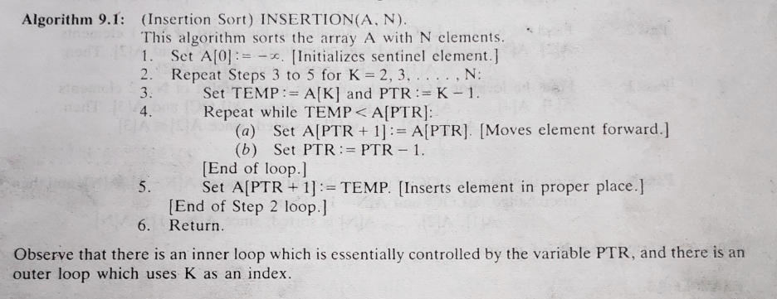
Insertion Sortin

Slide 15
Insertion sort: Example
Suppose an array A contains 8 elements as follows: 77, 33, 44, 11, 88, 22, 66, 55

Slide 16
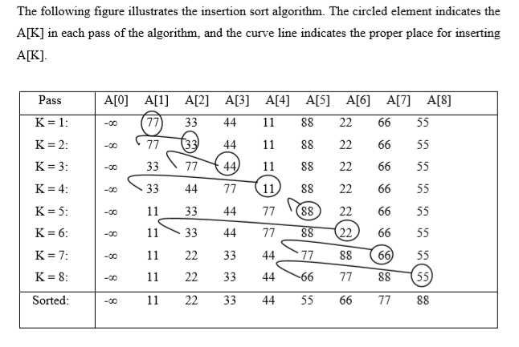

Slide 17
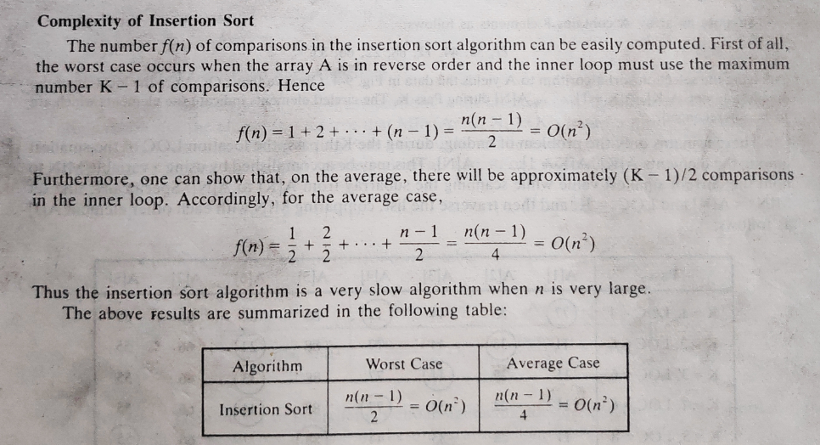
Insertion Sortin

Slide 18
Selection sort

Slide 19
Selection Sort
It works by ﬁnding the smallest or highest element (most probably desired element) from the unsorted list and swaps with the ﬁrst element in the sorted list and then ﬁnds the next smallest element from the unsorted list and swap with the second element in the sorted list. Consequently sorted elements are increasing at the top of an array and the rest will remain unsorted. The algorithm continues this operation until the list being sorted.

Slide 20
Selection Sort
Suppose an array with n elements A[1], A[2],…..,A[N] is in memory. The selection sort algorithm for sorting A works as follows.
First find the smallest element in the list and put it in the first position.
Then find the second smallest element in the list and put it in the second position.
And so on.

Slide 21
Selection Sort
More precisely:
Pass 1. Find the location LOC of the smallest in the list of N elements A [1], A [2],…., A [N], and then interchange A[LOC] and A[1]. Then A [1] is sorted.
Pass 2. Find the location LOC of the smallest in the sublist of N – 1 elements A[2], A[3],….., A[N], and then interchange A[LOC] and A[2]. Then A[1], A[2] is sorted, since A[1] ≤ A[2]

Slide 22
Selection Sort
Pass 3. Find the location LOC of the smallest in the sublist of N – 2 elements A[3], A[4],…., A[N], and then interchange A[LOC] and A[3]. Then A[1], A[2],…., A[3] is sorted, since A[2] ≤ A[3].
----------------------------------------------------------------------------------------------------------------------
Pass N – 1. Find the location LOC of the smaller of the elements A[N – 1], A[N], and then interchange A[LOC] and A[N – 1]. Then A[1], A[2],………, A[N] is sorted, since A[N – 1] ≤ A[N]. Thus A is sorted after N – 1 passes.

Slide 23
Selection Sort: Example
Suppose an array A contains 8 elements as follows:
77, 33, 44, 11, 88, 22, 66, 55
Applying the selection sort algorithm to A yields the data in next slide. Observe that LOC gives the location of the smallest among A[K], A[K + 1],…, A[N] during Pass K. The circled elements indicate the elements which are to be interchanged.

Slide 24
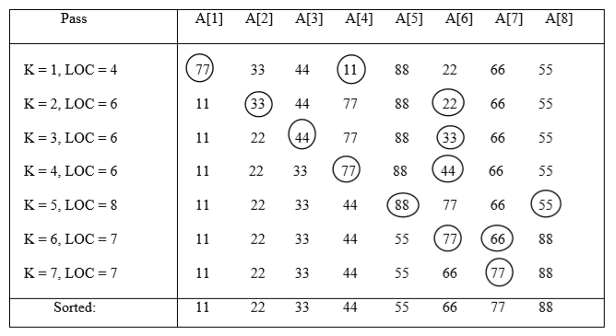
Selection Sort

Slide 25
Selection Sort: Example
There remains only the problem of finding, during the Kth pass, the location LOC of the smallest among the elements A[K], A[K + 1],….., A[N]. This may be accomplished by using a variable MIN to hold the current smallest value while scanning the subarray from A[K] to A[N].

Slide 26
Selection Sort: Example
Specifically, first set MIN := A[K] and LOC := K, and then traverse the list, comparing MIN with each other element A[J] as follows:
(a) If MIN ≤ A[J], then simply move to the next element.
(b) If MIN > A[J], then update MIN and LOC by setting MIN := A[J] and LOC := J.
After comparing MIN with the last element A[N], MIN will contain the smallest among the elements A[K], A[K + 1],….,A[N] and LOC will contain its location.

Slide 27
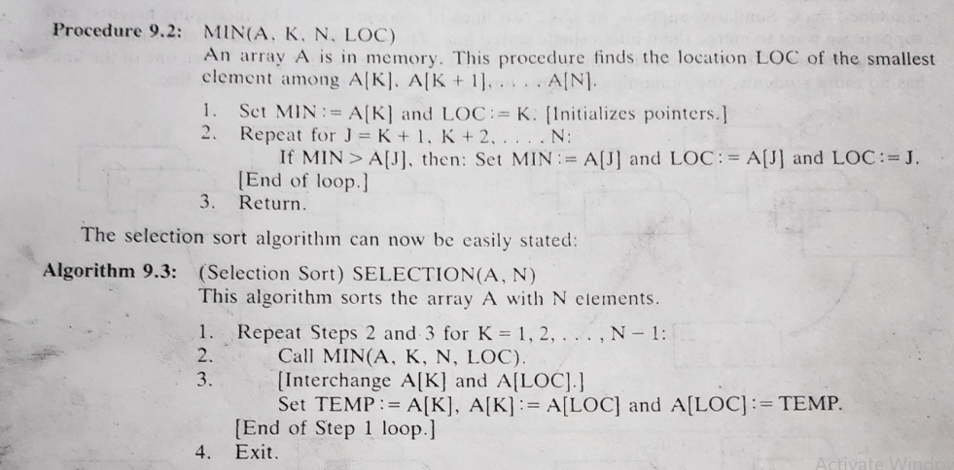
Selection Sort

Slide 28
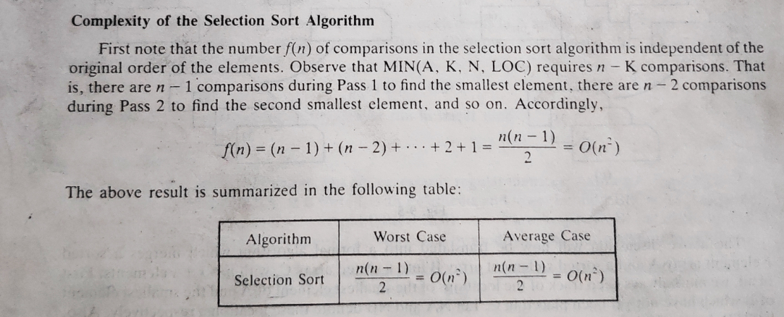
Selection Sort

Slide 29
Thank you……

